Slide 1
PROFESSIONAL DRESS
Guidelines and expectations

Slide 2
GENERAL RULES TO FOLLOW
No jeans
No athletic shoes
Skirts and dresses should be appropriate length
Girls: professional slacks or skirt with blouse or HOSA polo, BLACK slacks and dress shoes
Boys: BLACK Slacks and HOSA polo or suit and tie with dress shoes.
Ask yourself: should I wear this to a job interview??

Slide 3
Girls

Slide 5
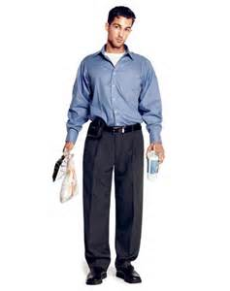
Business Casual- No points awarded

Slide 6
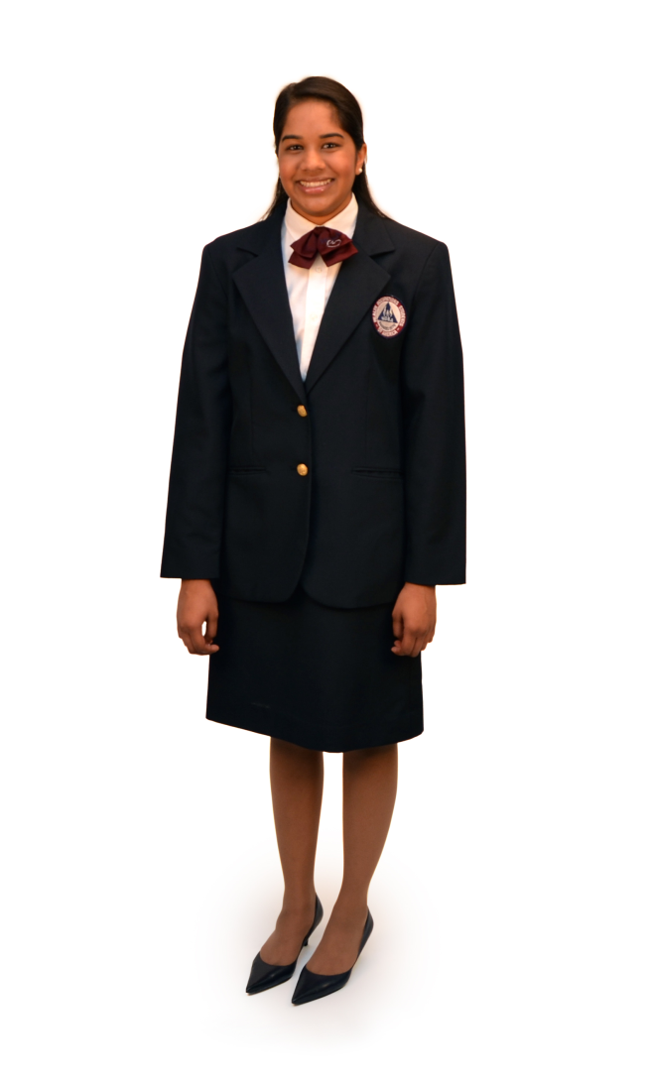
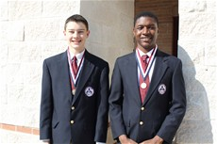
EXAMPLES FROM HOSA

Slide 7
“Busy Blues”
Wear your HOSA “busy blues” on Wednesday is acceptable to receive points- 3 points
Busy Blues are your HOSA POLO with black SLACKS and dress shoes
Wearing Khaki pants, jeans and/or gym shoes will not be accepted

Slide 8
Getting your points
ANY healthcare science teacher can sign off on your point sheet
Pictures of you in your HOSA/ Professional gear/ scrubs will NOT be accepted this year
You must wear your clothes ALL day
If you are seen later in a new outfit your points will be taken away

