Slide 1
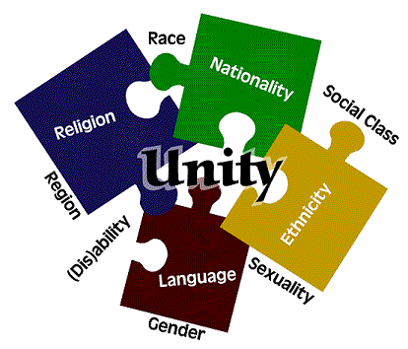
Cultural Diversity

Slide 2
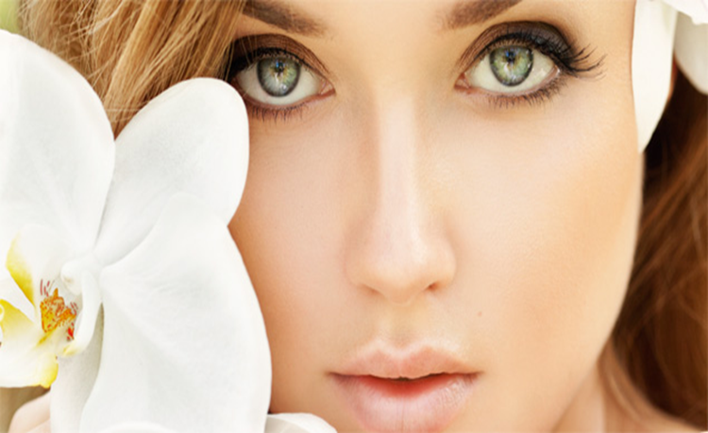
Beauty
What is considered beautiful?
What would we do to attain “beauty”?
Is beauty a social or individual concept?

Slide 3
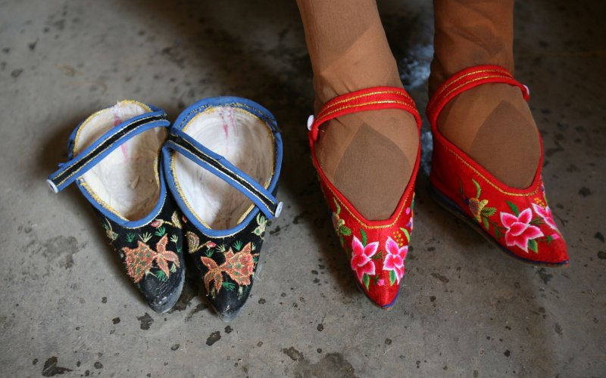
Chinese foot binding
Feet bound at early age
Sign of wealth and marriage eligibility
Believed to make the daughter more attractive to suitors
Outlawed in 1912, although some still secretly practiced
“lotus” shaped feet
Walking with bound feet

Slide 4
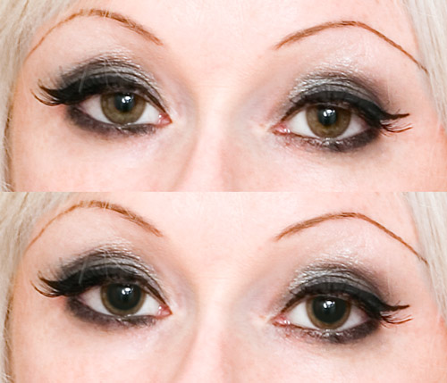
Italy: Bella Donna
In Italian literally meaning “beautiful” “lady”
Juice from the plant was consumed to dilate the pupils
Seen as beautiful to have large pupils
Can be poisonous!

Slide 5
Introduction
Healthcare workers must work with and provide care to a variety of people
YOU must be aware of factors that cause each individual to be unique
That uniqueness is influenced by many things:
  Physical characteristics
  Family life
  Socioeconomic status
  Religious beliefs
  Geographical location
  Education
  Occupation
  Life experiences
One major influence is the person’s cultural/ethical heritage

Slide 6
Culture
The values, beliefs, attitudes, languages, symbols, rituals, behaviors and customs unique to a particular group of people and that are passed down from generation to generation
Often defined as a set of rules, because each culture provides a “blueprint” for its standard of living
  Childrearing
  Education
  Occupational choice
  Social interactions
  Spiritual beliefs
  Healthcare choices

Slide 7
Culture is not always uniform, but it does provide a foundation for behavior
All cultures have 4 basic characteristics:
Culture is learned
Culture is shared
It is taught to others
Children learn patterns by imitating adults and developing attitudes accepted by others.
Common practices and beliefs are shared with others in a cultural group
Circumcisions are common practice within the Caucasian culture

Slide 8
Culture is social in nature
Culture is dynamic and constantly changing
Individuals in the group understand appropriate behavior based on traditions that have been passed down from generation to generation
Traditional Hispanic culture believe women marry and raise children – not get educated
New ideas may generate different standards for behavior
This allows members to meet the needs of the group by adapting to environmental changes

Slide 9
Ethnicity
Classification of people based on national origin and/or culture
May share common heritage, geographic location, social customs, language and beliefs
Every individual may not practice all of the beliefs of the group, but is still influenced by other members of the group
Within each ethnic group, there are numerous subgroups, each with its own lifestyle and beliefs, but from the same heritage

Slide 10
Race
Classification of people based on physical or biological characteristics
  Color of skin, hair & eyes
  Facial features
  Blood type
  Bone structure
Frequently used to “label” people and explain patterns of behavior
In reality, it is the values, beliefs and behaviors learned from the ethnical group that accounts for behaviors attributed to race.

Slide 11
Cultural diversity
Differences based on cultural, ethnical and racial factors
All these influence an individual’s behavior, self-perception, judgment of others and interpersonal relationships
Differences exist within all ethic/cultural groups and within the people that make up those groups

Slide 12
Continued…
Cultural assimilation
acculturation
Process that represents the absorption of many different cultures into a given area
U.S. is considered a “melting pot” due to all the cultures that live here
Process of learning the beliefs and behaviors of a dominant culture and assuming some of the characteristics
Occurs slowly over time

Slide 13
Sensitivity
Because healthcare workers provide care to ALL patients, they must be able to recognize and appreciate the personal characteristics of others
i.e. Calling an adult by their first name, in some cultures, is not acceptable except for family members
The Joy Luck Club

Slide 14
Bias, Prejudice & Stereotyping
bias
Prejudice
Preference that inhibits impartial judgment
All “whites” are superior
Young people are physically superior to old people
Women are inferior to men
College-educated people are superior to uneducated individuals
Pre-judging: a strong belief about a person/subject that is formed without reviewing facts of information
Every individual is prejudice to some degree, but in heath care, it can’t be shown

Slide 15
Bias, Prejudice & Stereotyping
stereotyping
Avoiding B, P, & S
Occurs when an assumption is made that everyone in a particular group is the same
All blondes are dumb
Every obese person eats too much
Be aware of own personal values/beliefs
Obtain info about different ethnic/cultural groups
Be sensitive to practices that are different
Ask questions and share ideas
Be open to differences
Avoid jokes that offend
Remember: you are not being asked to adopt other beliefs, just respect them

Slide 16
Family organization
Refers to the structure of a family and dominant decision-making person in the family

Slide 17
Family organization
Nuclear family
Extended family
Consists of mother, father, and children
May also consist of a single parent and children
Usually basic unit in European and American families
Includes nuclear family plus grandparents, aunts, uncles and cousins.
Usually the basic unit in Asian, Hispanic and Native-American families

Slide 18
Headship
patriarchal
matriarchal
Father or oldest male is the authority figure
Dominant male makes decisions regarding healthcare
Asian and Middle Eastern families, male have sole authority
The mother or oldest female is the authority figure

Slide 19
Language
In U.S. dominant language is English, but many other languages are spoken as well
2000 census stated that 20% of the population under age 65 speaks a language other than English
Must find a interpretor/translator to receive informed consent
  Speak slowly (not loudly)
  Use gestures, carefully
  Use non-verbal communication – smile, touch

Slide 20
Personal touch and space
“territorial space”
The distance people require to feel comfortable while interacting with others
Varies among different cultural groups
Always be alert to non-verbal clues
  Patient may get anxious when you get to close

Slide 21
Eye contact
Also affected by different cultural beliefs
Many feel eye contact during a conversation shows interest and trustworthiness
Some cultures consider eye contact to be rude
Native Americans may use peripheral eye contact instead of direct eye contact

Slide 22
Gestures
Used to communicate many things
Common gestures are nodding for “yes” and side-to-side for “no”, pointing is used to stress a specific idea
In India, nodding and shaking head mean the oppositie
Pointing in Asian and Native American cultures represent a strong threat

Slide 23
Health Care Beliefs
The most common health care system in the U.S. is based on “Western” system: bases for disease is due to microorganisms, diseased cells and aging. Healthcare is directed toward eliminating the cause.
Beliefs about a health care system vary among cultures, so patients regard healthcare differently
Every culture has a system for health care based on values & beliefs that have existed for generations
(graphic organizer for beliefs)

Slide 24
Spirituality/Religion
Part of every ethnic group
The belief individuals have about themselves, their connections with others and their relationship with a higher power
When spiritual beliefs are firmly established, the person has a basis for understanding life, finding sources of support when needed and drawing on inner/external resource to deal w/ situations that arise
Spirituality and Religion are NOT the same
Religion is an organized system of belief in a higher power

Slide 25
Spirituality/Religion
atheist
agnostic
A person who does not believe any diety (higher power) exists.
Person who believes that the existence of God cannot be proven or disproven, thereby doesn’t claim either.

Slide 26
Respecting Diversity
Key is to regard each person as a unique individual
Every individual adopts beliefs and forms patterns of behavior based on culture, ethnicity, race, life experiences, spirituality and religion
Beliefs may change based on new exposures and experiences
Must be aware of the needs of each individual in order to provide care

